Slide 1




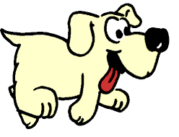


“No dogs rolled their balls.”

